Slide 1
Dynamic Noise and Pollution Street Map
using the Smart Citizen Kit
Peter Yordanov
Supervisors: Dr. Iadh Ounis and Richard McCreadie

Slide 2
What is this project about?
Addressing the problem of visualizing noise and air pollution
Using hardware sensor technology and software to retrieve environmental information about noise levels and air quality
Visualize the pollution levels

Slide 3
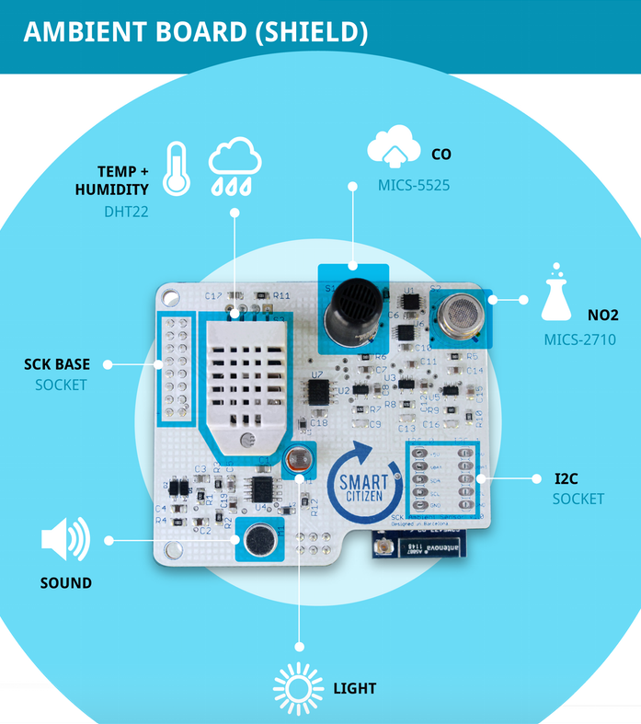
Smart Citizen Kit Sensors
Temperature/Humidity Sensor (HPP828E031)
Ambient Light Sensor (BH1730FVC)
NO2/CO Sensor (MICS-4514)
Omnidirectional Electret Condenser Microphone (POM-2246P-C33-R)

Slide 4
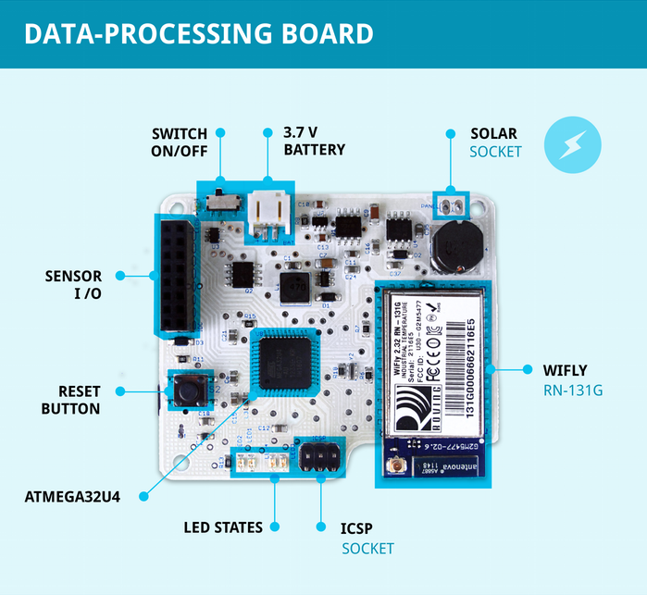
Smart Citizen Kit Data Processing
Uses a Wi-Fly (RN-131G) to connect to wireless networks and transmit environmental updates
Has a Li-Po battery charging circuitry, supporting a 3.7 V battery

Slide 5
Proposed Solution
Build a dynamic noise and pollution map of the campus
Use the GPS sensor of mobile devices for geolocation tracking and the Smart Citizen Kit for environmental data monitoring
Adopt the client-server model to create a distributed application
Build a 'thin' route tracking client
Develop a processing backend and a visualization UI on the server

Slide 6
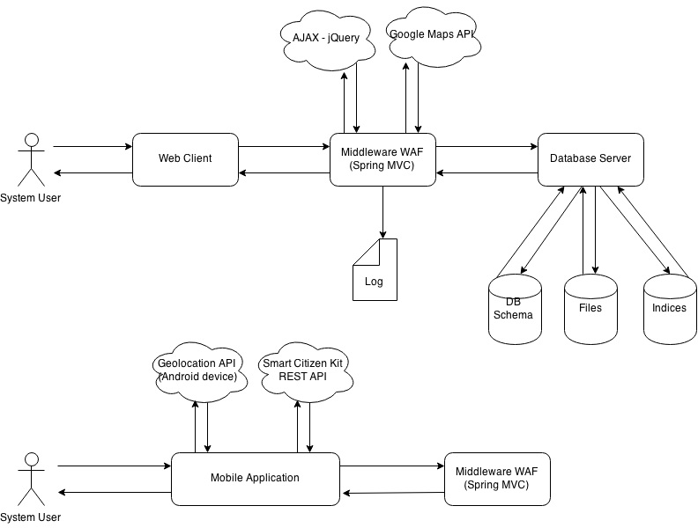
Implementation
Technologies used:
Server
Spring MVC running with Jetty servlet container
DBMS - Mongo DB
JavaServer Pages (JSP)
Twitter Bootstrap 3.3, jQuery
Google Maps API V3
Client
Apache PhoneGap
High-Level System Architecture

Slide 7
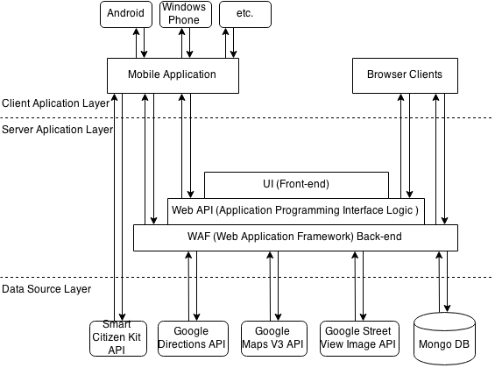
Application Layer Communication

Slide 8
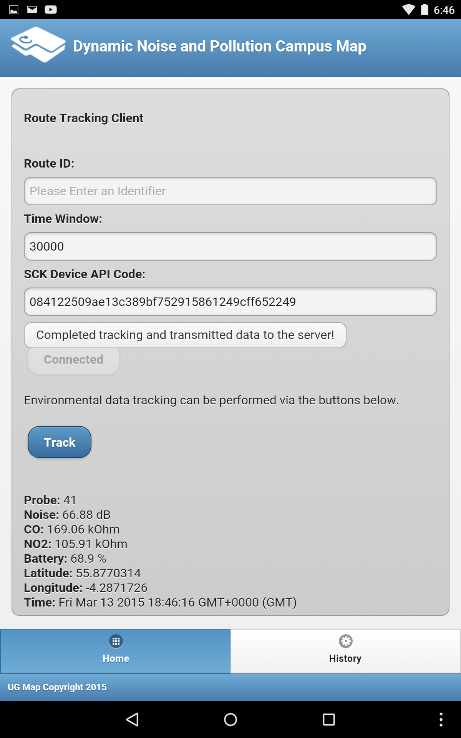
Android Client
Connects to a Smart Citizen Kit device using an API code
Retrieves sensor updates every 30 sec.
When the tracking session is complete, transmits updates to the application server

Slide 9
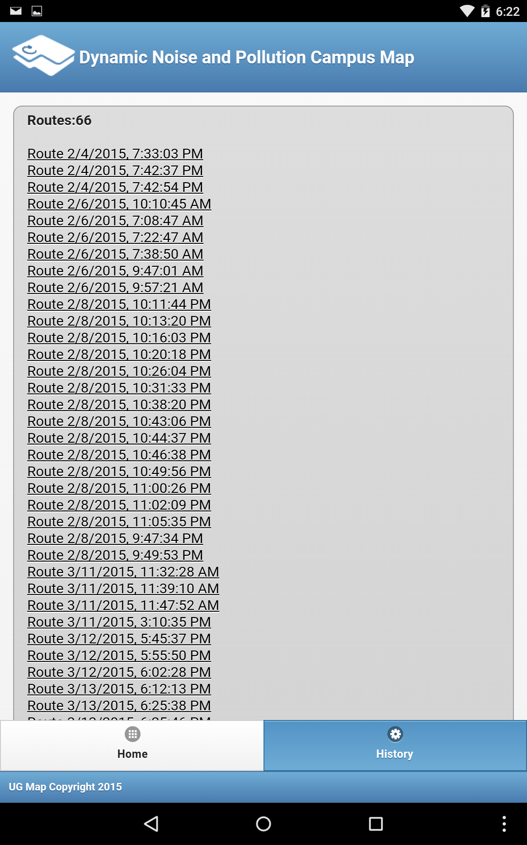
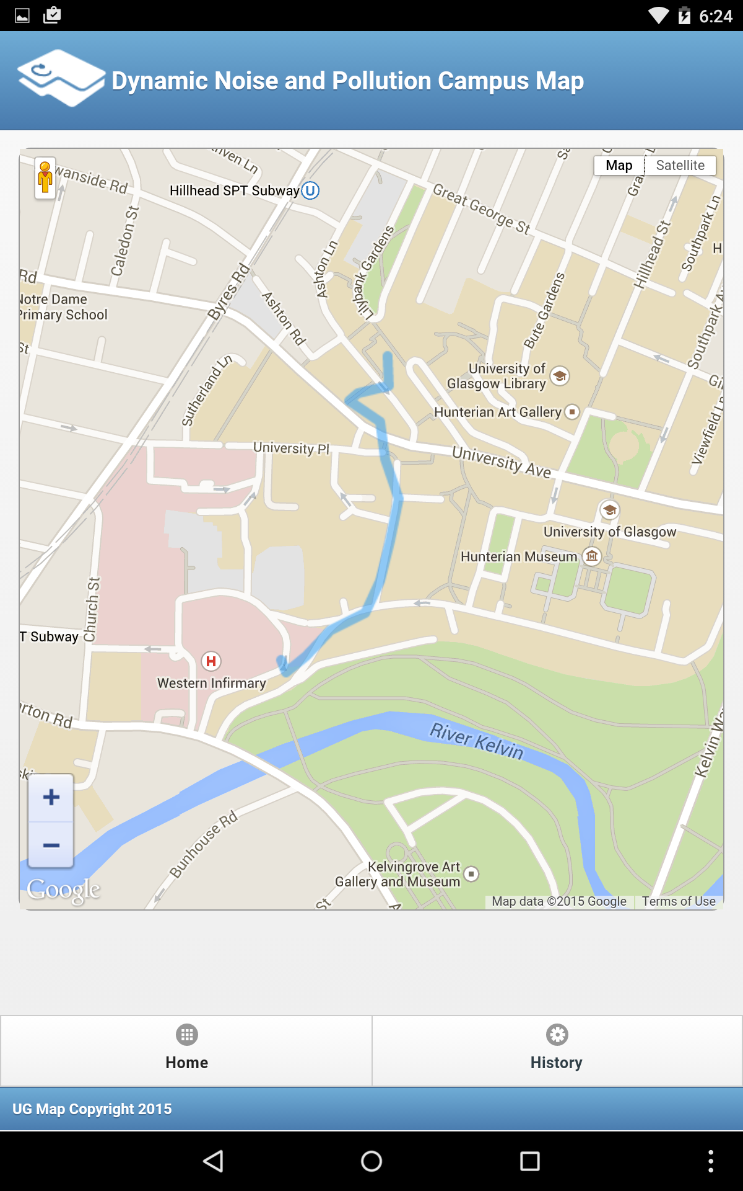
Android Client
Stores data collection sessions locally on the device
Allows users to inspect data on the map
History page
Route view (Android)

Slide 10
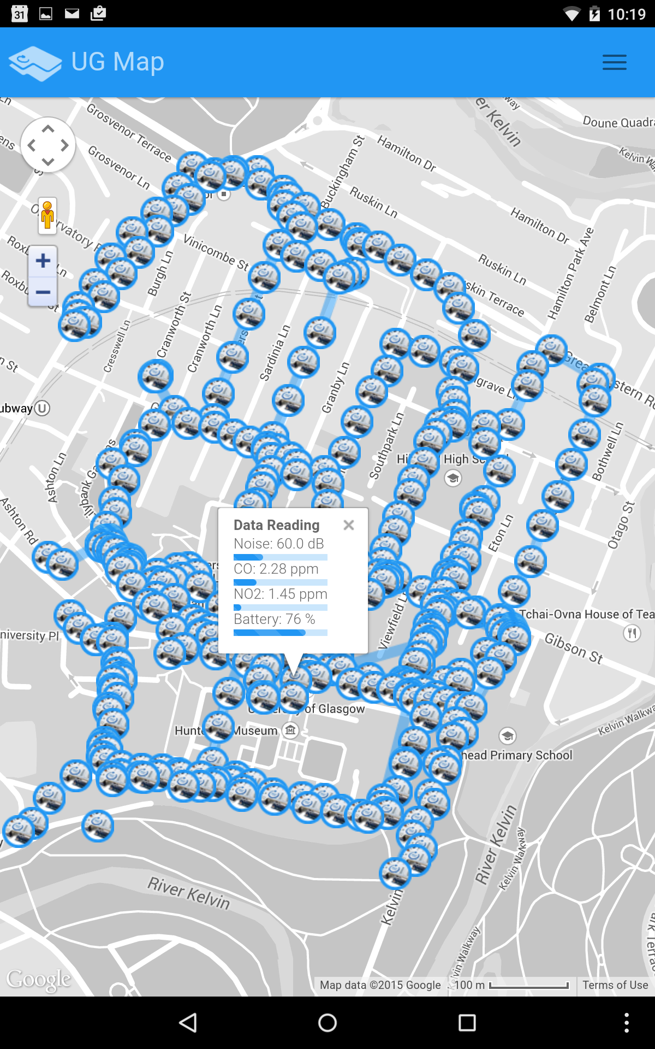
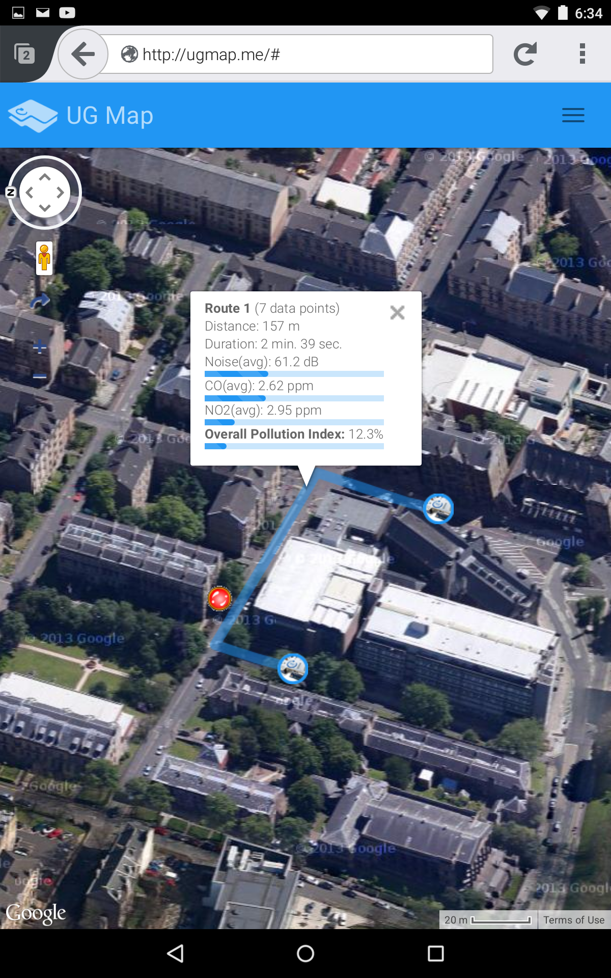
Visualization Server
Data points are aggregated on the Glasgow University campus map
Route information (including estimated distance and walking duratiuon) and user navigation (red dot) is also available
Data readings
Route, close-up

Slide 11
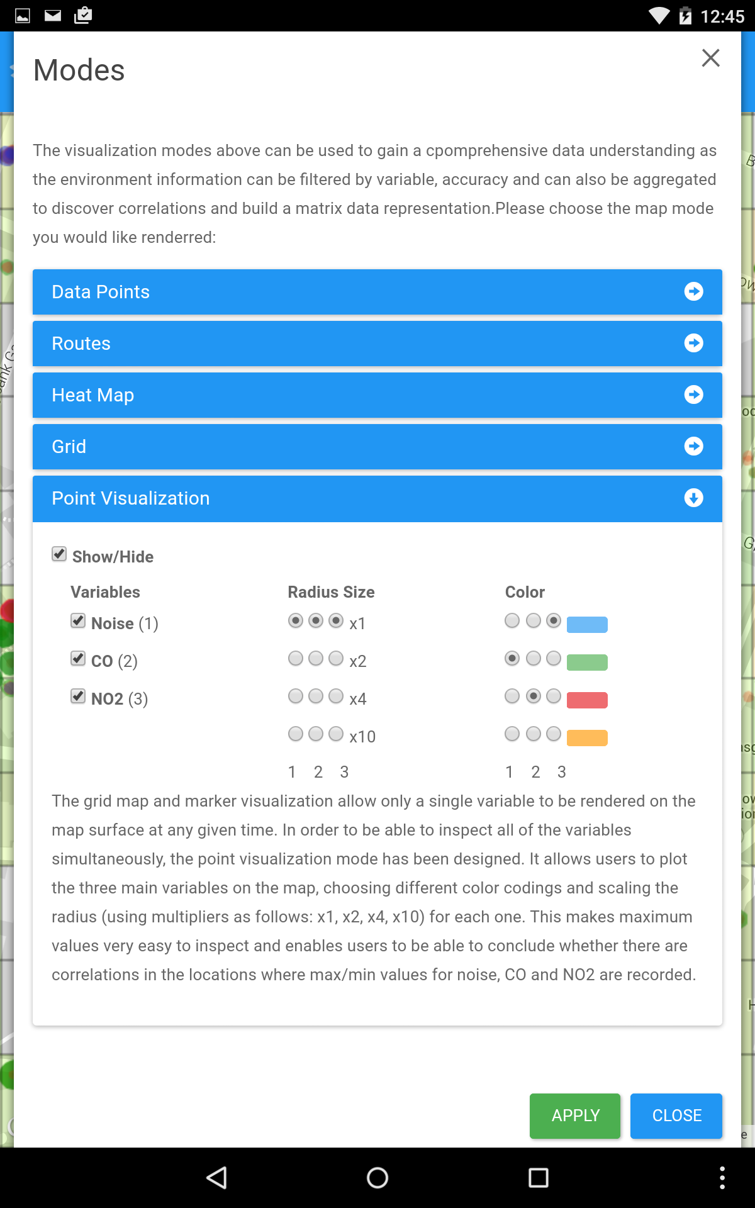
Visualization Server - Data Points
Users can select variables to be rendered and configure scaling and color-coding
Data points plot configuration

Slide 12
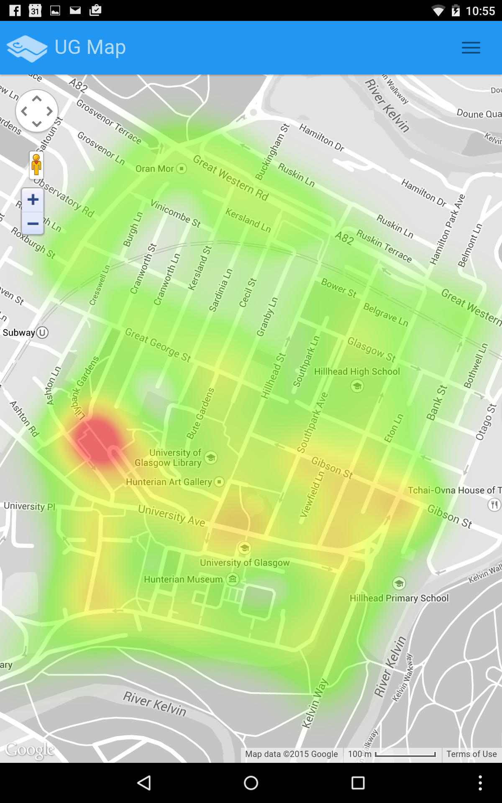
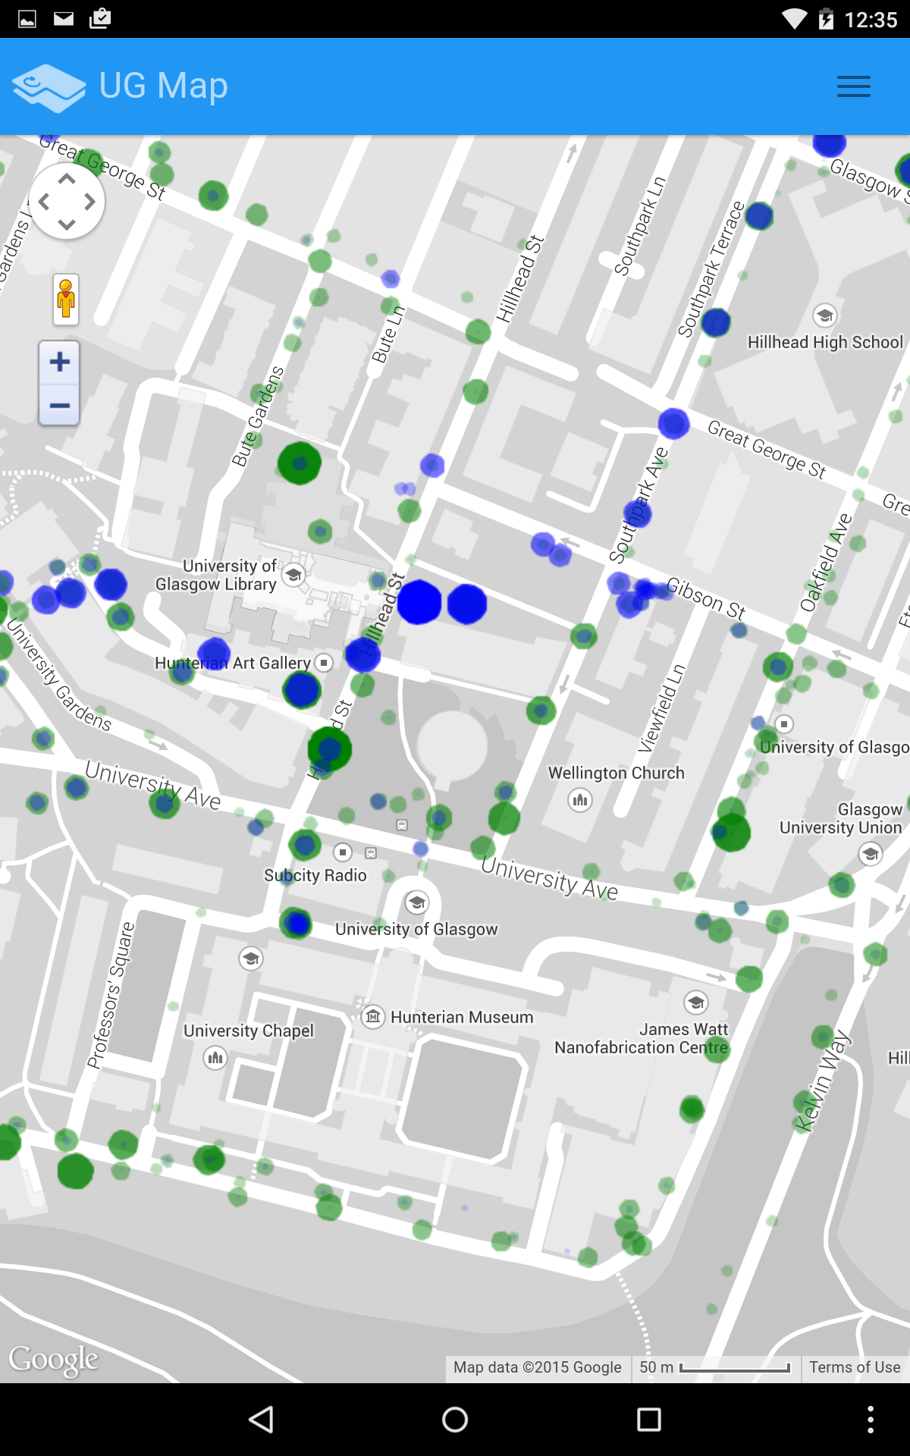
Visualization Server - Data Points
Can generate a heat map of the data points to show highest concentration areas
The configuration options allow multiple variables to be plotted on the map to inspect correlations between areas with highest values; comparison criteria are circle radius and transparency depending on the value
Data readings heat map
noise - green, NO2 - blue

Slide 13
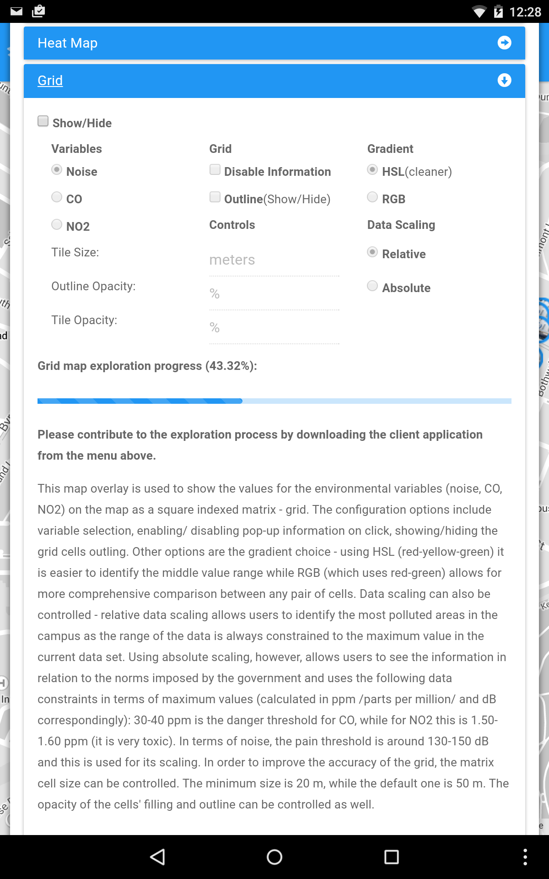
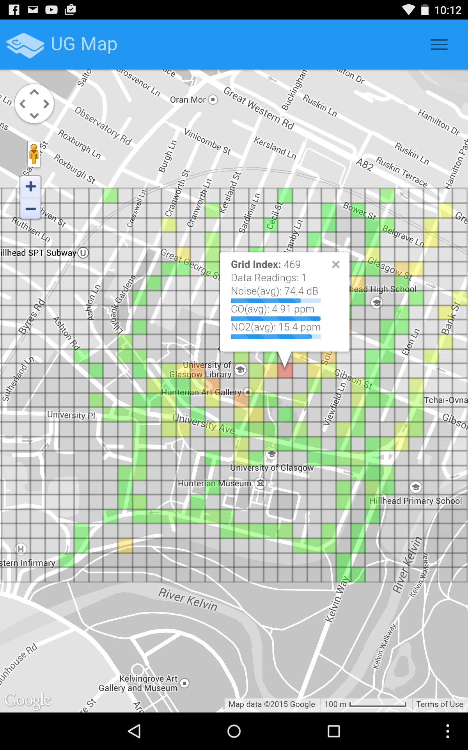
Visualization Server - Grid
Users can choose the variable to be rendered and specify matrix cell size (incl. other options)
Grid configuration
25 m grid cell, NO2

Slide 14
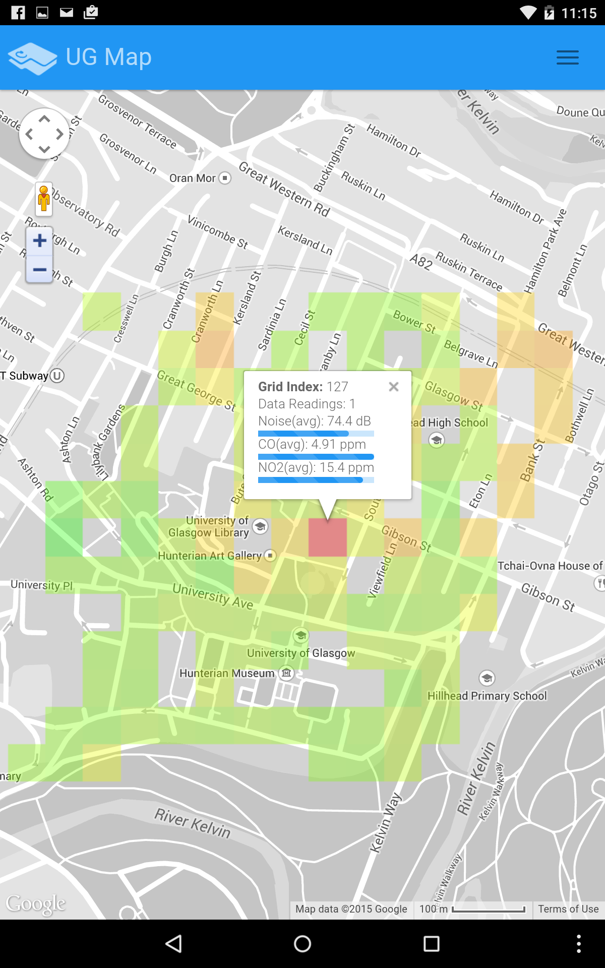
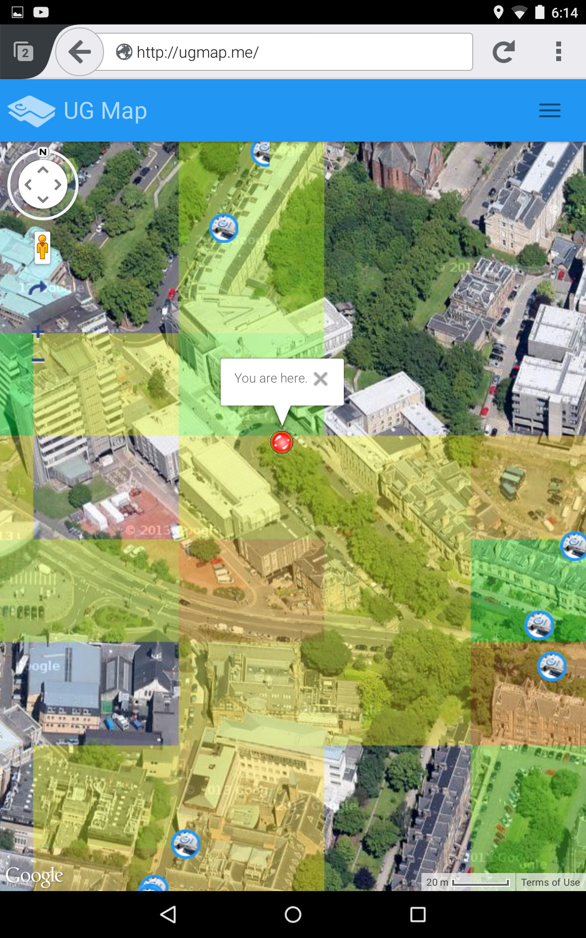
Visualization Server - Grid
An indexed grid map for noise, CO and NO2 can be generated (default cell size is 50x50m) with color-coding depending on the variable values within the bounds of each cell
Information can be explored by clicking on each cell
Users can inspect the grid map while walking around the campus (example: noise map satellite view)
50x50m grid cell, CO
satellite view, noise

Slide 15
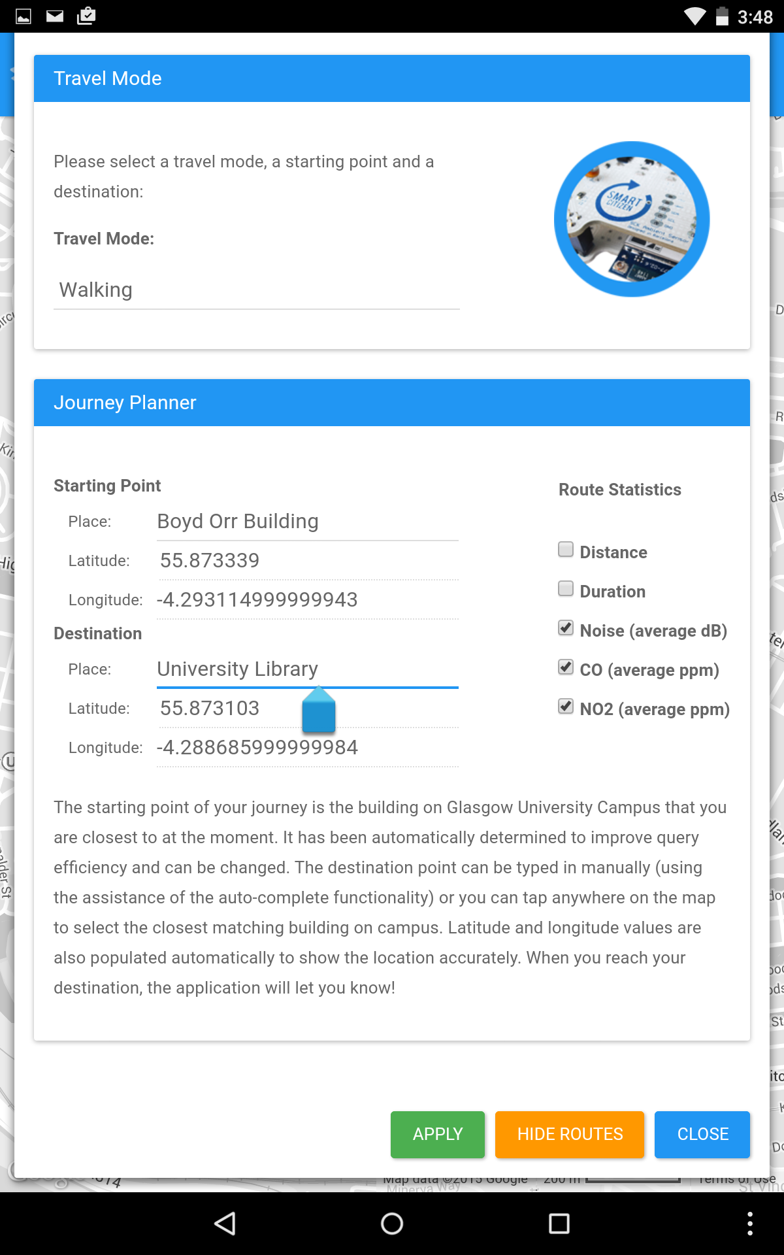
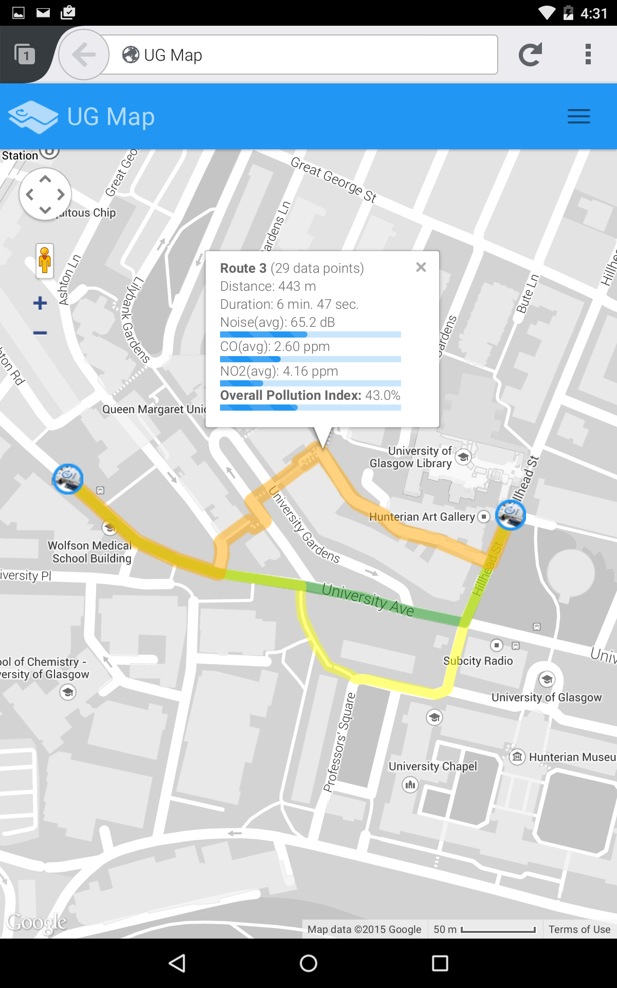
Visualization Server - Route Recommendation
Route generation is based on the Google Directions API and the data aggregated in the indexed grid structure
Showing the route statistics (overall pollution index) for the Boyd Orr - University Library route recommendations (rightmost figure)
Route recommendation configuration
Suggested routes based on sorting criteria

Slide 16
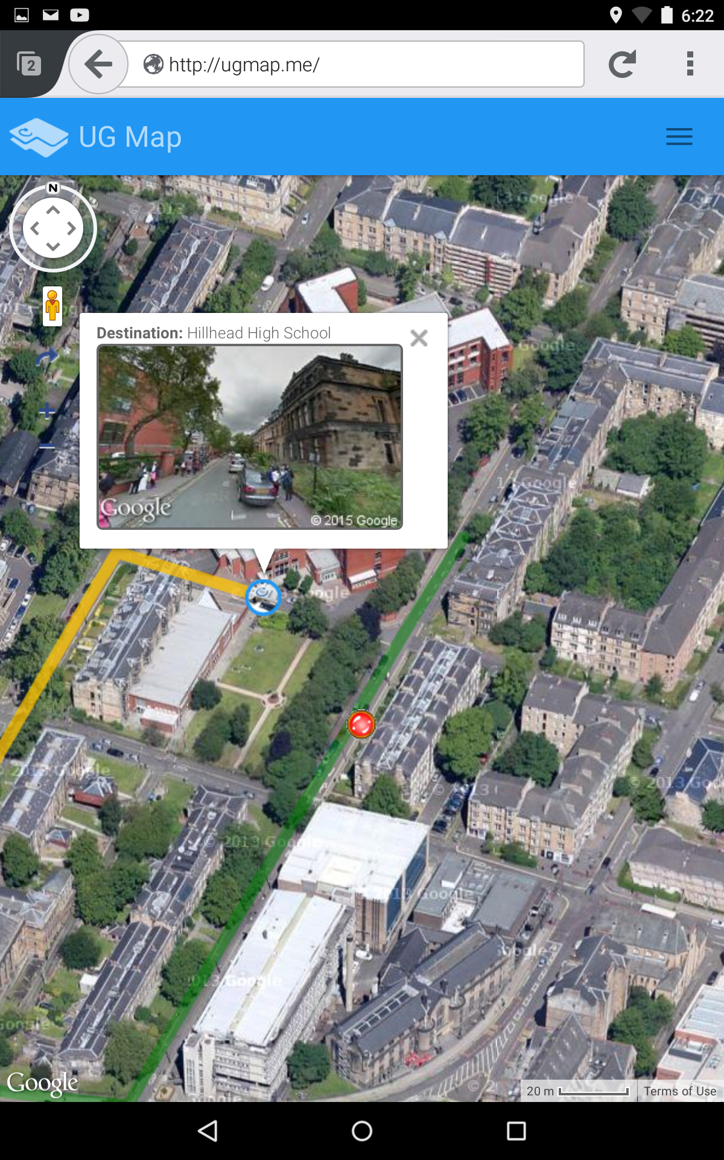
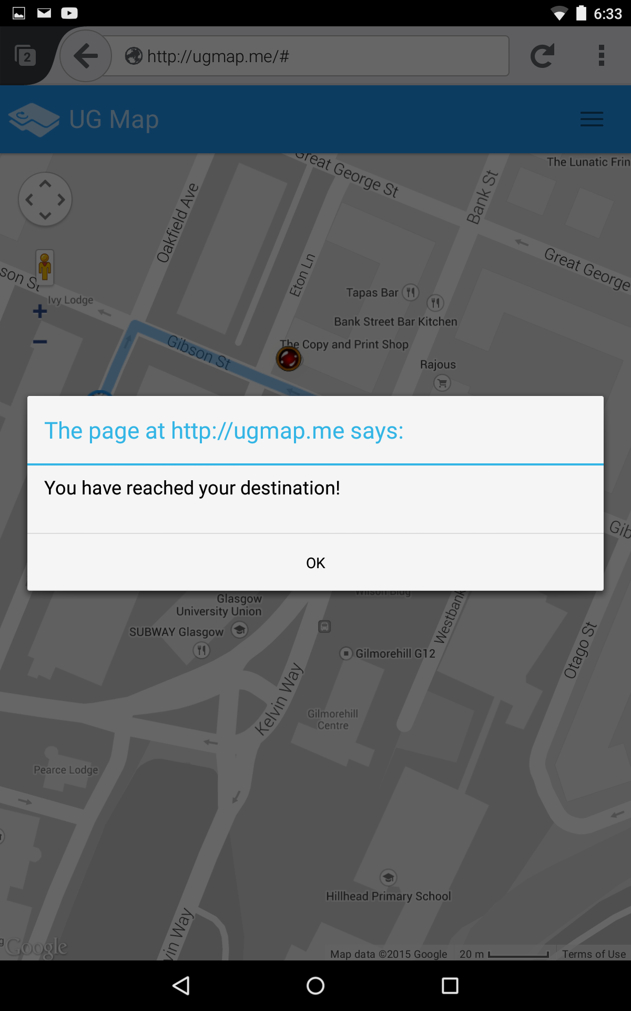
Server
User navigation (right)
Other features:
data filtering
campus locations browsing
Boyd-Orr - Hillhead High School user navigation
Destination reached

Slide 17
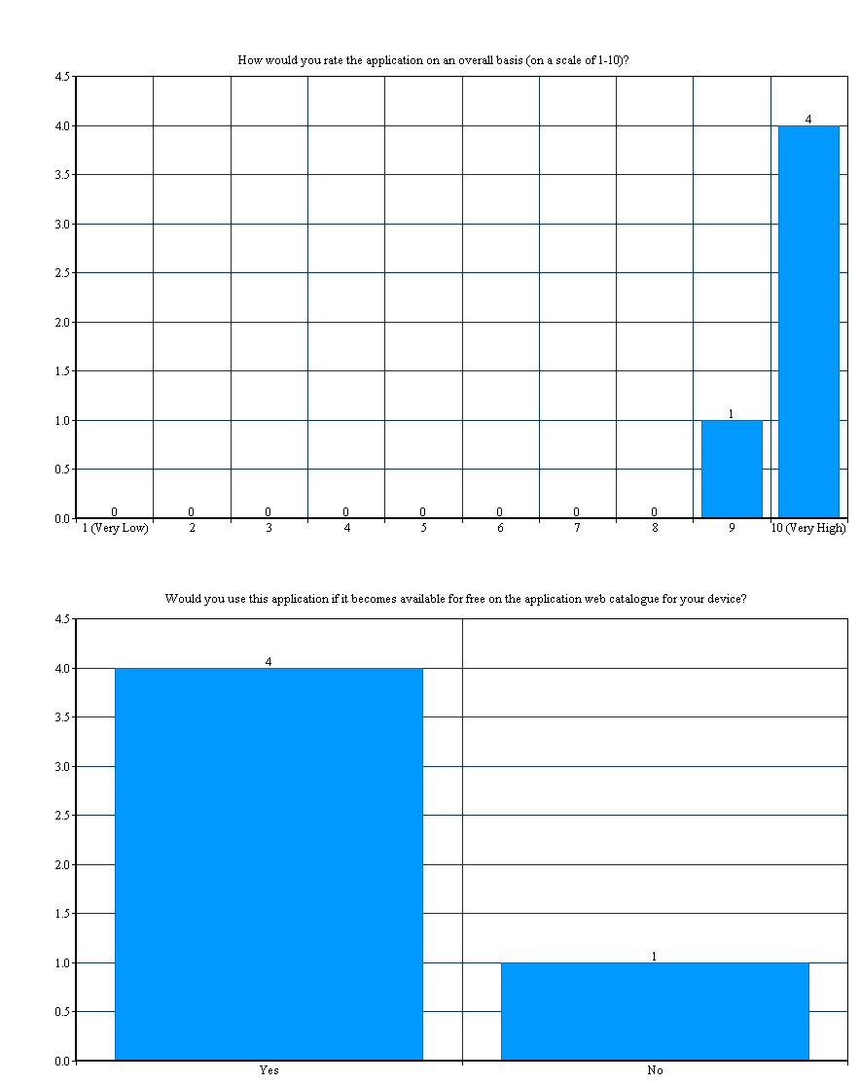
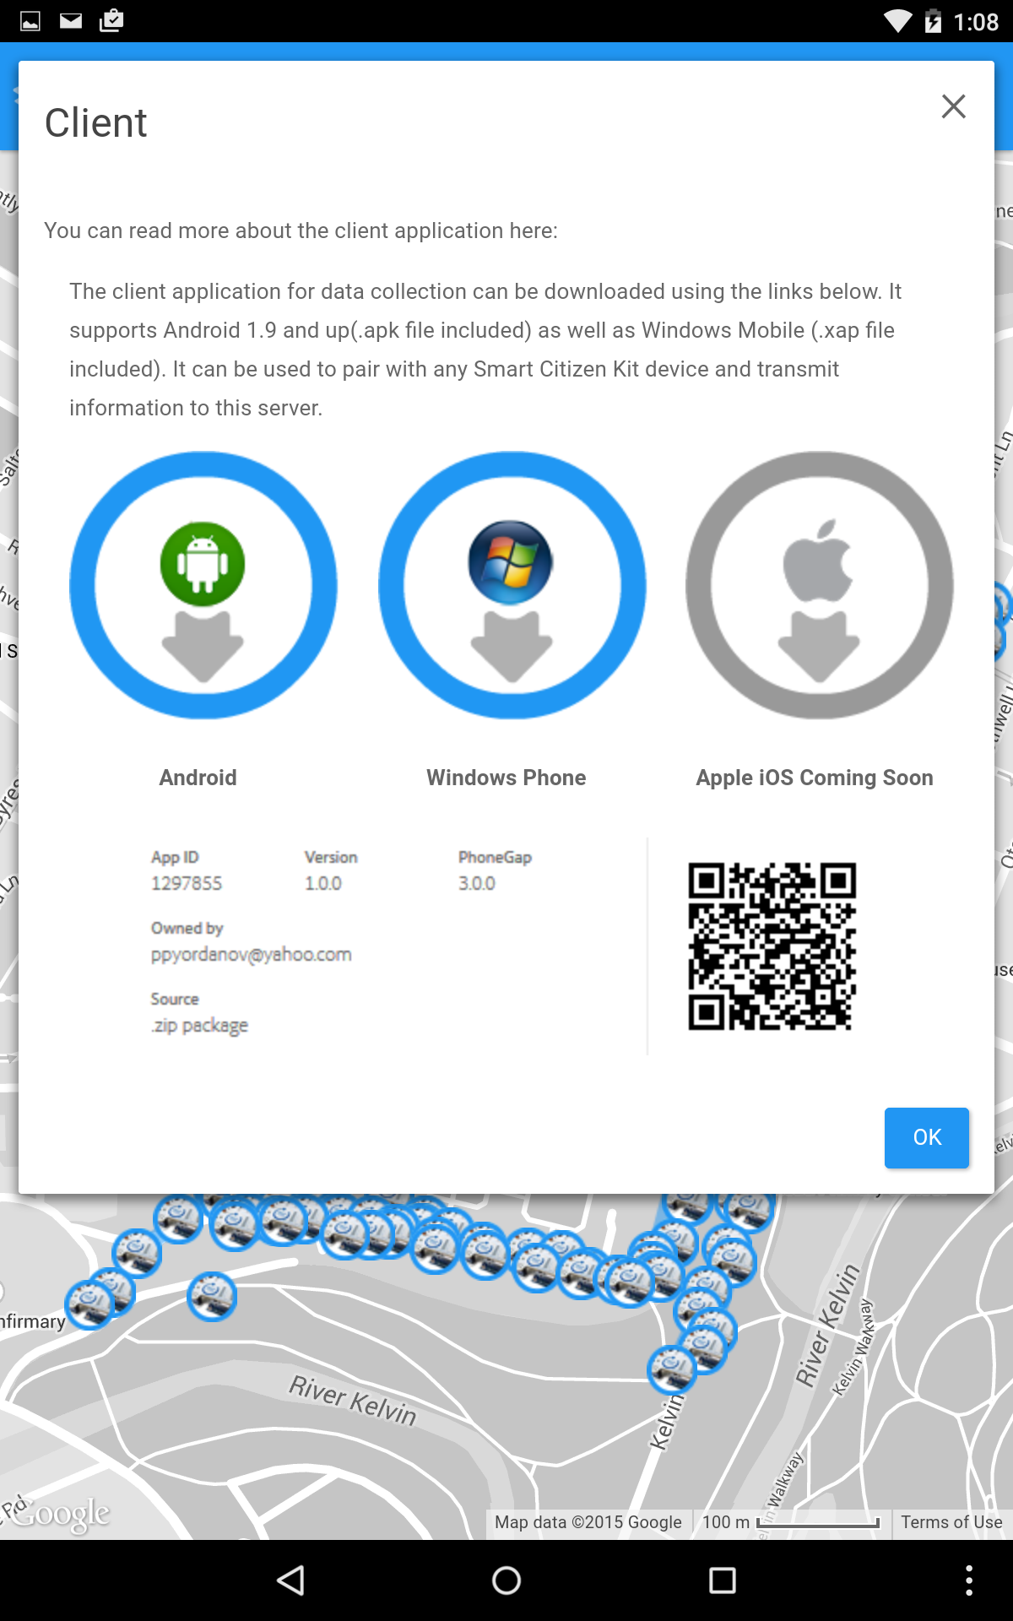
Evaluation
Conducted 2 evaluation sessions (pilot and final)
Results have indicated that the application is useful and most participants would use it if it is released on Google Play (and/or Apple Store)
Client application download links added to the server
Overall ratings
Client download links

Slide 18
Final Words
The client application is now available for Android and Windows Phone
Suggestions for improvement have been identified (e.g. user navigation on the server) during the evaluation
Experience gained:
Android development (Apache PhoneGap)
NoSQL DBMS (Mongo DB)
RESTful mobile web application development (Spring MVC)
Server application available at : http://ugmap.me/

Slide 19
Questions?

Slide 20
Thank you!

